Slide 1

Time Series Forecasting Using RNN
Author: Rahul Birwadkar
Supervisor: Prof. Dr.-Ing. Milan Gnjatović

Slide 2
Agenda
Introduction
Objective
Methodology
Data Preprocessing
Feature Engineering
LSTM Architecture
Evaluation Metrics
Results and Analysis
Conclusion

Slide 3
Introduction
Definition of Time Series Data:
Sequential historical measurements indexed by time.
Importance of Time Series Forecasting:
Applications in finance, medicine, agriculture, etc.
Challenges in Time Series Forecasting:
Handling temporal dependencies, non-stationarity, need for advanced models.

Slide 4
Objective of the Project
Objective: Predict stock prices using LSTM (Long Short-Term Memory) networks.
Approach:
Model Types: LSTM and Multilayer LSTM.
Evaluation Metrics: RMSE, MAE, and R².

Slide 5
Methodology
Data Preprocessing:
Loading and filtering the dataset, indexing with 'Date', and normalizing data.
Feature Engineering:
Using a sliding window approach to capture temporal dependencies.
LSTM Model Architecture:
Single-layer and multi-layer configurations.

Slide 6
Data Preprocessing
Loading the Dataset:
Tata Motors' stock prices from 2014-2024.
Indexing and Visualization:
Set 'Date' as index; visualized data trends.
Normalization:
Used MinMaxScaler to scale values between 0-1.

Slide 7
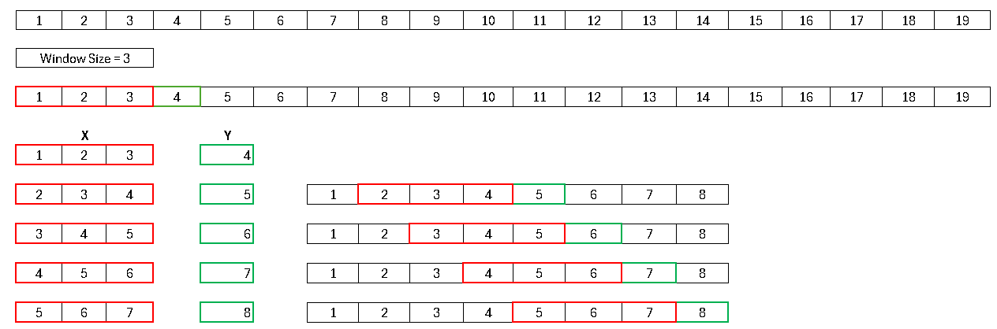
Feature Engineering
Sliding Window Approach:
Used a 10-day look-back window to create input features and targets.

Slide 8
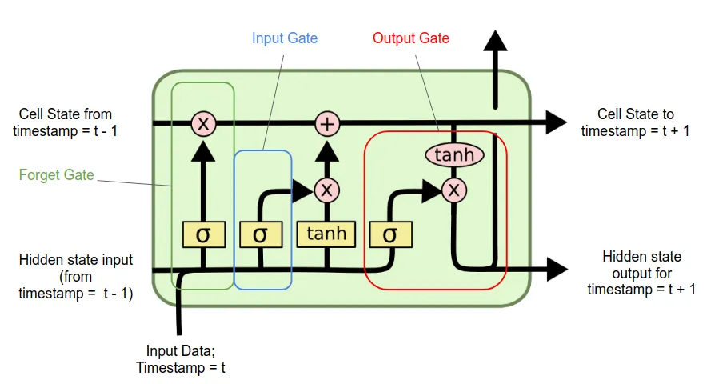
LSTM Architecture
Data Preprocessing:
Loading and filtering the dataset, indexing with 'Date', and normalizing data.
Feature Engineering:
Using a sliding window approach to capture temporal dependencies.
LSTM Model Architecture:
Single-layer and multi-layer configurations.

Slide 9
Evaluation Metrics
Root Mean Squared Error (RMSE)
Mean Absolute Error (MAE)
R² Score

Slide 10
Results and Analysis
Number of Layers:
Increasing layers may lead to overfitting.
Number of Neurons:
More neurons generally improved accuracy but increased complexity.
Batch Size and Epochs:
Best results with smaller batch sizes.
Increasing epochs improved accuracy up to a limit.
Dropout:
Effective in reducing overfitting.

Slide 11
Conclusion
Effectiveness of LSTM:
Demonstrated high accuracy in predicting stock prices, capturing temporal dependencies effectively.
Future Work:
Incorporating external factors like market sentiment for better predictions, testing hybrid models.

Slide 12
Thank You ! ☺

